Slide 1
Reading 1

Slide 2

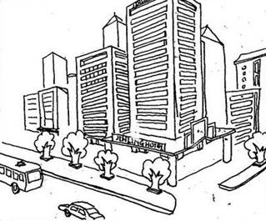

D R _ Text 1
LEARNING, CHINESE-STYLE
Russell Baker
For a month in the spring of 1987, my wife Ellen and I lived in the bustling eastern Chinese city of Nanjing with our 18-month-old son Benjamin while studying
arts education in Chinese kindergartens and elementary schools. But one of the most telling lessons Ellen and I got in the difference between Chinese and American ideas of education came not in the classroom but in the lobby of the Jinling Hotel where we stayed in Nanjing.

Slide 3


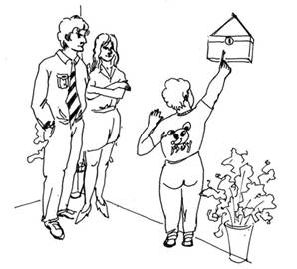

D R _ Text 2
The key to our room was attached to a large plastic block with the room number on it. When leaving the hotel, a guest was encouraged to turn in the key, either by handing it to an attendant or by dropping it through a slot into a box.
Because the key slot was narrow, the key had to be positioned carefully to fit into it.
Benjamin loved to carry the key around, shaking it vigorously. He also liked to try to place it into the slot. Because of his tender
age and incomplete understanding of the need to position the key just so, he would usually fail. Benjamin was not bothered in the least. He probably got as much pleasure out of the sounds the key made as he did those few times when the key actually found its way into the slot.

Slide 4
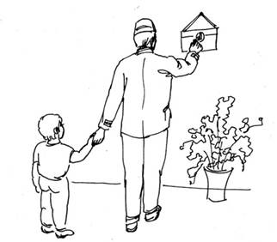
D R _ Text 3
Now both Ellen and I were perfectly happy to allow Benjamin to bang the key near the key slot. His exploratory behavior seemed harmless enough. But I soon observed an interesting phenomenon. Any
Chinese staff member nearby would come over to watch Benjamin and, noting his lack of initial success, attempt to assist. He or she would hold onto Benjamin’s hand and, gently but firmly, guide it directly toward the slot, reposition it as necessary, and help him to insert it. The “teacher” would then smile somewhat expectantly at Ellen or me, as if awaiting a thank you — and on occasion would frown slightly, as if considering us to be neglecting our parental duties.

Slide 5
D R _ Text 4
I soon realized that this incident was directly relevant to our assigned tasks in China: to investigate the ways of early childhood education (especially in the arts), and to throw light on Chinese attitudes toward creativity. And so before long I began to introduce the key-slot anecdote into my discussions with Chinese educators.
TWO DIFFERENT WAYS TO LEARN
With a few exceptions my Chinese colleagues displayed the same attitude as the staff at the Jinling Hotel. Since adults know how to place the key in the key slot, which is the ultimate purpose of approaching the slot, and since the child is neither old enough nor clever enough to realize the desired action on his own, what possible gain is achieved by having him struggle?

Slide 6

D R _ Text 5
He may well get frustrated and angry — certainly not a desirable outcome. Why not show him what to do? He will be happy, he will learn how to accomplish the task sooner, and then he can proceed to more complex activities, like opening the door or asking for the key — both of which accomplishments can (and should) in due course be modeled for him as well.
We listened to such explanations sympathetically and explained that, first of all, we did not much care whether Benjamin succeeded in inserting the key into the slot. He was having a good time and was exploring, two activities that did matter to us. But the critical point was that, in the process, we were trying to teach Benjamin that one can solve a problem effectively by oneself.

Slide 7
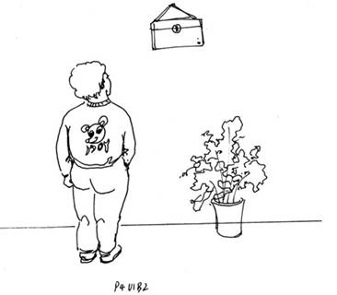
D R _ Text 6
Such self-reliance is a principal value of child rearing in middle-class America. So long as the child is shown exactly how to do something — whether it be placing a key in a key slot, drawing a hen or making up
for a misdeed — he is less likely to figure out himself how to accomplish such a task. And, more generally, he is less likely to view life — as Americans do — as a series of situations in which one has to learn to think for oneself, to solve problems on one’s own and even to discover new problems for which creative solutions are wanted.

Slide 8
D R _ Text 7
TEACHING BY HOLDING HIS HAND
In retrospect, it became clear to me that this incident was indeed key — and key in more than one sense. It pointed to important differences in the educational and artistic practices in our two countries.
When our well-intentioned Chinese observers came to Benjamin’s rescue, they did not simply push his hand down clumsily or uncertainly, as I might have done. Instead, they guided him with extreme facility and gentleness in precisely the desired direction. I came to realize that these Chinese were not just molding and shaping Benjamin’s performance in any old manner: In the best Chinese tradition, they were ba zhe shou jiao — “teaching by holding his hand” — so much so that he would happily come back for more.

Slide 9
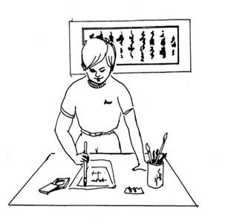
D R _ Text 8
The idea that learning should take place by continual careful shaping and molding applies equally to the arts. Watching children at work in a classroom setting, we were astonished by their facility. Children as young as 5 or 6 were
painting flowers, fish and animals with the skill and confidence of an adult; calligraphers 9 and 10 years old were producing works that could have been displayed in a museum. In a visit to the homes of two of the young artists, we learned from their parents that they worked on perfecting their craft for several hours a day.

Slide 10
D R _ Text 9
CREATIVITY FIRST?
In terms of attitudes to creativity there seems to be a reversal of priorities: young Westerners making their boldest departures first and then gradually mastering the tradition; and young Chinese being almost inseparable from the tradition, but, over time, possibly evolving to a point equally original.
One way of summarizing the American position is to state that we value originality and independence more than the Chinese do. The contrast between our two cultures can also be seen in terms of the fears we both harbor. Chinese teachers are fearful that if skills are not acquired early, they may never be acquired; there is, on the other hand, no comparable hurry to promote creativity.

Slide 11
D R _ Text 10
American educators fear that unless creativity has been acquired early, it may never emerge; on the other hand, skills can be picked up later.
However, I do not want to overstate my case. There is enormous creativity to be found in Chinese scientific, technological and artistic innovations past and present. And there is a danger of exaggerating creative breakthroughs in the West. When any innovation is examined closely, its reliance on previous achievements is all too apparent (the “Standing on the shoulders of giants” phenomenon).

Slide 12
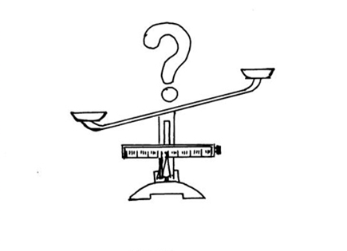
D R _ Text 11
But assuming that the contrast I have developed is valid, and that the fostering of skills and creativity are both worthwhile goals, the important question becomes this: Can we gather, from the Chinese and American extremes, a superior way to approach education, perhaps striking a better balance between the poles of creativity and basic skills?

